Slide 1

What is a randomised controlled trial?
Jack Wilkinson
Centre for Biostatistics
University of Manchester
With thanks to Prof Richard Emsley and Dr Lesley-Anne Carter

Slide 2
Motivation
Our topic on this course is testing health interventions.
- Does this treatment improve (or worsen) outcomes?

Slide 3
Motivation
Our topic on this course is testing health interventions.
- Does this treatment improve (or worsen) outcomes?

Slide 4
Intervention?
Could be all kinds of things e.g:
A drug (paracetamol for pain relief)
A surgical procedure (coronary artery bypass for heart disease)
An AI algorithm (prognostic model for patients with heart failure)

Slide 5
Motivation
Our topic on this course is testing health interventions.
- Does this treatment improve (or worsen) outcomes?
Premise: we have an obligation to test interventions in a robust manner.
  - Surprisingly controversial? What’s the harm?

Slide 6
Motivation
Our topic on this course is testing health interventions.
- Does this treatment improve (or worsen) outcomes?
Premise: we have an obligation to test interventions in a robust manner.
  - Surprisingly controversial? What’s the harm?
  - Treatments may make things worse, as well as better!

Slide 7
Motivation
Our topic on this course is testing health interventions.
- Does this treatment improve (or worsen) outcomes?
Premise: we have an obligation to test interventions in a robust manner.
  - Surprisingly controversial? What’s the harm?
  - Treatments may make things worse, as well as better!
  Question: How can we do that?

Slide 8
Motivation
Our topic on this course is testing health interventions.
- Does this treatment improve (or worsen) outcomes?
Premise: we have an obligation to test interventions in a robust manner.
  - Surprisingly controversial? What’s the harm?
  - Treatments may make things worse, as well as better!
  Question: How can we do that?
  - Randomised controlled trials (or randomised clinical trials, RCTs).

Slide 9
What are randomised controlled trials (RCTs)?
We will explain by contrasting to other types of clinical studies (non-randomised, observational).

Slide 10
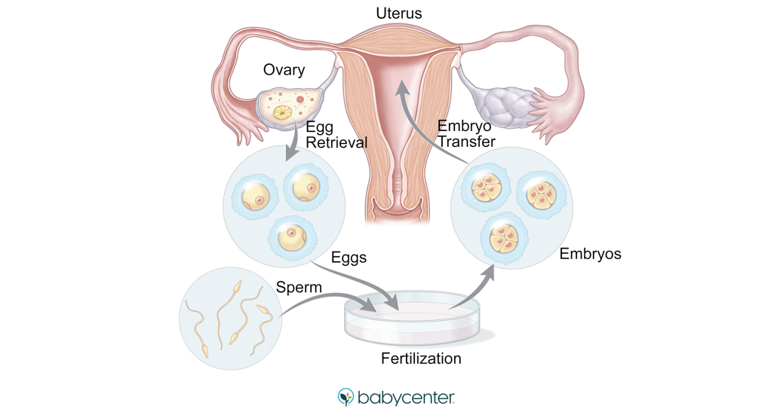
Some clinical background for our examples today
We are going to look at two examples relating to in vitro fertilisation (IVF).
People undergo IVF when they are having fertility problems.
The goal of treatment is to help them have a baby.

Slide 11
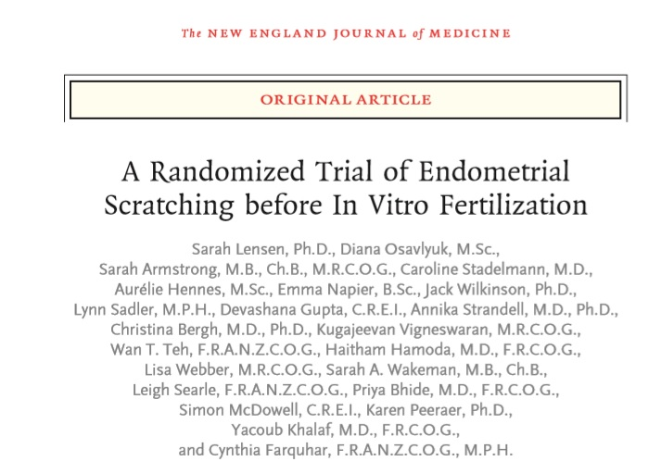
Example of an RCT
Q: If we scratch the inside of the uterus before in vitro fertilisation (IVF), does it improve the chance of having a baby?

Slide 12

Example of a non-randomised study
A cohort study
Q: Does use of enriched embryo culture medium improve the chance of having a baby?
‘Culture medium’ is the liquid used to grow embryos in IVF.
Will use these to illustrate key features of RCTs
You will learn to design, analyse, interpret and critically appraise clinical studies on this unit.

Slide 13
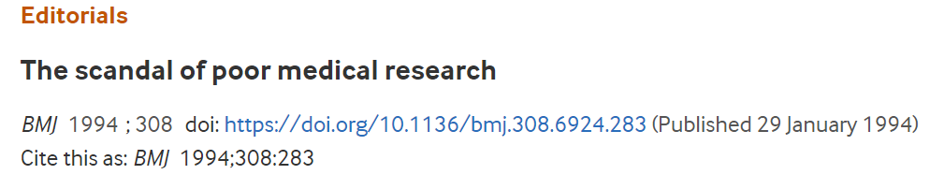
Much medical research is low quality
“Much poor research arises because researchers feel compelled for career reasons to carry out research that they are ill equipped to perform, and nobody stops them.” Doug Altman, 1994.
Medical researchers routinely get the wrong answers to research questions, because they don’t understand research design and statistical methodology.
But bad research = bad medicine (and wasted resources).

Slide 14
But good clinical research is hard
Good clinical research: easier said than done
Interpreting/ critically appraising isn’t easy either
There are many aspects to consider:
Control group
Blinding
Analysis
Outcome assessment
Primary outcome
Sample size/ power
Randomisation
Allocation concealment
Choice of sample...
We will learn about the importance of these features in this unit!

Slide 15
Some terminology: treatment groups, control groups, and outcomes.

Slide 16
Some terminology
Treatment/ intervention/ exposure group: used to mean the group of participants being given the treatment under evaluation in the study. (Also ‘experimental’ group/ treatment).
Control group: the group to which the treatment group is being compared.

Slide 17
Treatment and control groups
Treatment/ intervention/ exposure group: used to mean the group of participants being given the treatment under evaluation in the study. (Also ‘experimental’ group/ treatment).
The treatment group underwent endometrial scratching before having IVF.
A control (comparator) group underwent IVF without endometrial scratching. Note they still had some treatment (IVF).

Slide 18
Treatment and control groups
Treatment/ intervention/ exposure group: used to mean the group of participants being given the treatment under evaluation in the study. (Also ‘experimental’ group/ treatment).
The treatment group(s) had embryos cultured in enriched culture medium.
A control (comparator) group had embryos cultured in normal culture medium.
Note: this study actually considered two enriched groups.

Slide 19
Outcomes
Outcome variable: A measure of the patient’s health post-treatment (e.g. how they responded to treatment … were patients’ blood glucose levels ‘better controlled’ if they wore a blood glucose monitor?).
Often, we want to find out about the effect of the treatment on the outcome variable.

Slide 20
Study outcomes
Study outcome: A measure of patient response to treatment. Used to evaluate the effect of the treatment/ intervention.
The primary outcome of the study was live birth. Compared live birth rate (proportion of participants having live births) between treatment and control groups to determine whether endometrial scratching had any effect.
Other, secondary outcomes included ongoing pregnancy, clinical pregnancy, ectopic pregnancy, pain during the procedure, neonatal outcomes…

Slide 21
Study outcomes
Study outcome: A measure of patient response to treatment. Used to evaluate the effect of the treatment/ intervention.
The primary outcome of the study was again live birth. Compared live birth rate (proportion of participants having live births) between treatment and control groups to determine whether enrichment had any effect.
Other, secondary outcomes included biochemical pregnancy, clinical pregnancy, multiple live births, early pregnancy loss, late miscarriage, neonatal outcomes…

Slide 22
Does the treatment work?
A comparison between the responses (outcomes) in the treatment group vs the responses in the control group is used to test whether the treatment under study works.

Slide 23
Why do we need control groups?

Slide 24
Why do we need control groups?
Suppose you are ill, and we want to know whether we should give you a particular treatment, or some alternative (a control).
Ideally, to make that decision, we would like to know what would happen to you (that is, what your outcome would be) if we gave you each of the treatment and control.
We can give you one of them, and see what happens. But we will never know if that is better or worse than what would have happened if we had given you the other treatment instead.
RCTs are an attempt to estimate the ‘what would have happened’.
More precisely, they attempt to estimate the difference between outcomes under the two possible scenarios – we call this difference the treatment effect.

Slide 25

Why do we need control groups?
Fundamental concept of causal inference
Receive treatment
Receive control
Measured outcome
Measure outcome
Comparison of outcomes would give an individual treatment effect (but we only see one of these!)

Slide 26

Why do we need control groups?
Fundamental concept of causal inference
Receive treatment
Receive control
Measure outcome
Measure outcome
Comparison of these outcomes will not give an individual treatment effect

Slide 27
Why do we need control groups?
Fundamental concept of causal inference
So we can’t (usually) work out the individual treatment effect, without a time machine, or the ability to travel into parallel universes.
What about if we could take everyone who was ill with the same condition, and observe their outcomes under both treatments (we can’t for most conditions – we still have no time machine - but imagine).
We could then calculate the individual treatment effects for everyone. And we could calculate the mean of these – the average treatment effect.
It turns out, if we randomly allocate (randomise) each person to receive either the treatment or control, then the difference in mean outcomes between groups is an unbiased estimate of the average treatment effect.

Slide 28



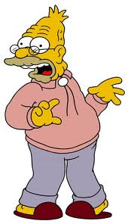

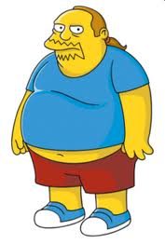

Why do we need control groups?
Fundamental concept of causal inference
Receive treatment
Measure outcome
Receive control
Measure outcome
Comparison of average outcomes defines the average treatment effect

Slide 29
Why do we need control groups?
Fundamental concept of causal inference
Randomise treatment*
Measure outcome
Randomise control*
Measure outcome
*Or successfully control for confounding another way in a non-randomised study
Comparison of average outcomes estimates the average treatment effect

Slide 30
Why do we need control groups?
Fundamental concept of causal inference
Moreover, it turns out that if we take a random sample of people from the population of interest, and randomly allocate them to receive either treatment or control, then the sample average treatment effect is an estimate of the population average treatment effect! (caveats…)
Our estimate of the average treatment effect is usually the best estimate we can get of the individual treatment effect.

Slide 31
Summarising
A comparison between the responses (outcomes) in the treatment group vs the responses in the control group is used to test whether the treatment under study works.
The question we are trying to answer is: are patients better off when given the treatment compared to how they would have been if they had been given the control?
We can’t observe both possibilities in patients – we must observe one or the other (treatment or control). The other is counterfactual.
The comparison between treatment and control groups stands in for this impossible ‘multiple reality’ comparison, but we need to use random allocation (or successfully control for confounding in a non-randomised study)

Slide 32
So control groups are essential
It follows that we can’t usually determine whether or not a treatment works without a control group.
A common fallacy – looking to see if people in treatment group ‘got better’ or ‘got worse’.
This doesn’t tell us anything about the counterfactual – what would have happened to them otherwise.
Example: anti-ageing cream. After 40 years, participants look 20 years older. They ‘got worse’ = cream doesn’t work?

Slide 33
Why do we prefer random allocation to treatments?

Slide 34
How is treatment allocated?
There are two generic types of research study:
  Observational
  Experimental

Slide 35
Different types of research study
Experimental studies
We do manipulate the treatment variable – we decide who does and does not get treated
Then collect the data and compare outcomes between those treated and those untreated

Slide 36
Different types of research study
Observational studies
We do not directly manipulate the treatment variable
We then observe the outcome in people who have been treated, and compare to people who have not been treated.

Slide 37
How is treatment allocated?
How do we determine who ends up in the treatment or control groups?
In experimental studies, we have direct control over who enters the treatment and control groups.
A randomised controlled trial (RCT) is an example of an experimental study.
Participants were randomly allocated to IVF with (treatment group) or without (control group) endometrial scratch.

Slide 38
How is treatment allocated?
How do we determine who ends up in the treatment or control groups?
In observational studies, we do not have direct control over this – we just observe the outcome in people who have been given the intervention, and compare to people who have not.
A cohort study is an example of an observational study.
It is also an example of a non-randomised study of an intervention.
Changes in clinical practice in the centre: compared outcome of patients prior to and after introduction of HA-rich culture medium.

Slide 39
Experimental vs observational studies
All RCTs are experimental.
But not all experimental studies are RCTs! People could allocate treatments in a non-random way (non-randomised study of an intervention (NRSI)).
The distinction we are really interested in in this course is between RCTs and NRSI.
NRSI may be observational or experimental.
Note: there are lots of different study designs which could be called ‘observational’, but which have nothing to do with testing interventions (e.g. developing a clinical prediction model using electronic health records).

Slide 40
RCTs are experimental studies, NRSI may be experimental or observational
Experimental studies
Observational studies
RCTs
Non-Randomised Studies of Interventions

Slide 41
What is Bias?
In medical research, bias occurs when some factor systematically corrupts the result of a study – it makes us get the wrong answer.
If there is bias: if we were to repeat the study many times over, our results would be too large or too small (or even in the wrong direction) compared to the truth (which we never know).
Bias can be introduced in two ways:
  Due to the design of the study.
  Related to properties of the method you use to analyse the data.

Slide 42
What is Bias?
Bias, particularly relating to design, is a major concern in medical research.
It may occur in many different ways.
It is a greater problem in non-randomised studies than RCTs.
Next week, we will learn about different kinds of bias in RCTs, and how to prevent these
This week we will just consider a particular types of bias, called confounding bias.

Slide 43
Why do we prefer random allocation?
Main reason: non-randomised studies are subject to confounding.
Example: coffee causes cancer
Suppose an observational study suggests that coffee causes cancer:
Coffee
Consumption
Cancer
Uh oh!

Slide 44
Confounding example: coffee causes cancer?
Smoking
Coffee
Consumption
Cancer
Maybe coffee drinkers tend to be smokers, and smoking causes cancer. If so, smoking is a confounder. It made us think that coffee caused cancer!

Slide 45
Confounding in non-randomised studies
Age
Treatment
Outcome
In NRSI, treatment and control groups might systematically differ in other ways (in addition to treatment received).

Slide 46
What goes into the decision of how to treat a patient (shared decision making)?

Slide 47
What goes into the decision of how to treat a patient (shared decision making)?
cost
Experiences of friends/ family
Cause of subfertility
Number of previous attempts
age
previous stimulation response
clinician experience with ‘similar patients’
BMI
duration of infertility
online information
ovarian reserve
evidence
Previous fertilisation issues
Notes:
You take into account these things because they matter – they influence outcome

Slide 48
These factors may be associated with other characteristics in complex ways
smoking
alcohol
ethnicity
cost
Experiences of friends/ family
Cause of subfertility
Number of previous attempts
metabolic disease
age
previous stimulation response
diet
clinician experience with ‘similar patients’
BMI
comorbidity
duration of infertility
online information
medical history
ovarian reserve
evidence
social economic status
employment
Previous fertilisation issues

Slide 49
A treatment might be offered at some clinics, not others
smoking
alcohol
ethnicity
cost
Experiences of friends/ family
Cause of subfertility
Number of previous attempts
metabolic disease
age
previous stimulation response
diet
clinician experience with ‘similar patients’
BMI
comorbidity
duration of infertility
online information
medical history
ovarian reserve
evidence
social economic status
employment
Previous fertilisation issues

Slide 50
Possible differences between centres…
embryology lab conditions
smoking
clinician experience
alcohol
ethnicity
cost
Experiences of friends/ family
Cause of subfertility
Number of previous attempts
embryo selection procedures
metabolic disease
age
previous stimulation response
diet
clinician experience with ‘similar patients’
clinician skill
BMI
comorbidity
duration of infertility
online information
medical history
ovarian reserve
evidence
social economic status
employment
diagnostic tests
Previous fertilisation issues
incubators
culture media

Slide 51
Who knows what else?
?
embryology lab conditions
?
smoking
ethnicity
clinician experience
?
cost
Experiences of friends/ family
Cause of subfertility
?
Number of previous attempts
embryo selection procedures
metabolic disease
age
previous stimulation response
diet
clinician experience with ‘similar patients’
clinician skill
?
BMI
comorbidity
duration of infertility
online information
?
medical history
ovarian reserve
evidence
social economic status
employment
diagnostic tests
Previous fertilisation issues
?
incubators
culture media
?
Notes:
Lots of this stuff can’t be nicely elaborated

Slide 52

smoking
embryology lab conditions
There is a unique ‘story’ or profile in the background, every time a patient is treated.
?
clinician skill
previous attempts
?
age
?
?
ovarian reserve
incubators
ethnicity
?
BMI
medical history

Slide 53
smoking
embryology lab conditions
There is a unique ‘story’ or profile in the background, every time a patient is treated.
?
clinician skill
previous attempts
?
age
?
?
This profile determines whether or not treatment is likely to work.
ovarian reserve
incubators
ethnicity
?
BMI
medical history

Slide 54
In NRSI, we take a group who were treated one way and compare them to a group who were treated a different way
Group A
Group B

Slide 55
In NRSI, we take a group who were treated one way and compare them to a group who were treated a different way
Group A
Group B

Slide 56
In NRSI, we take a group who were treated one way and compare them to a group who were treated a different way
?
Group A
Group B
?
duration of infertility
duration of infertility
?
?
social economic status
social economic status
BMI
BMI
?
?
age
?
age
?
culture media
culture media

Slide 57
Dealing with confounding in non-randomised studies
Without randomisation, treatment and control groups may systematically (as opposed to randomly) differ in terms of prognostic characteristics.
May also differ in terms of co-interventions: different incubators? Different lab conditions etc.
A simple comparison between groups no longer reflects the treatment effect – also reflects the fact that one group is older (for example).
Usual approach is to try to adjust for confounding in the statistical analysis: regression, propensity score methods (or both at once).

Slide 58
Example
Used logistic regression to adjust for a number of measured confounders: incubator, number of embryos transferred, method of fertilisation (IVF vs ICSI), treatment attempt, embryo culture duration (2,3, or 5 days).

Slide 59
In NRSI, we take a group who were treated one way and compare them to a group who were treated a different way
?
Group A
Group B
?
duration of infertility
duration of infertility
?
?
social economic status
social economic status
BMI
BMI
?
?
age
?
age
?
culture media
culture media

Slide 60
In NRSI, we take a group who were treated one way and compare them to a group who were treated a different way
?
Group A
Group B
?
duration of infertility
duration of infertility
?
?
social economic status
social economic status
BMI
BMI
?
?
age
?
age
?
culture media
culture media
Notes:
We can adjust for things that we know about and that we can measure well e.g. using an algorithm, or matching, or restricting to people with given characteristics

Slide 61
Unmeasured Confounding
So how much unmeasured stuff is there? In any individual study, we cannot know
Analyses of non-randomised studies assume no unmeasured confounding.
Unrealistic to suppose we have measurements of everything, let alone good measurements (biology is really complex).
As such, we are usually left uncertain whether an observed difference between groups in an observational study is due to the treatment or due to unmeasured confounding.

Slide 62
Unmeasured Confounding (2)
In practice, people adjust for a relatively modest number of variables
Complexity of the statistical method does not change this – can only include measured variables.
Size of the dataset does not ameliorate this problem in any way.

Slide 63
Problem is comparing groups that systematically differ
?
Group A
Group B
?
duration of infertility
duration of infertility
?
?
social economic status
social economic status
BMI
BMI
?
?
age
?
age
?
culture media
culture media

Slide 64
This doesn’t change if you increase sample size
?
Group A
Group B
?
duration of infertility
duration of infertility
?
?
social economic status
social economic status
BMI
BMI
?
?
age
?
age
?
culture media
culture media

Slide 65
This doesn’t change if you increase sample size
?
Group A
Group B
?
duration of infertility
duration of infertility
?
?
social economic status
social economic status
BMI
BMI
?
?
age
?
age
?
culture media
culture media
… even if you make it really big!

Slide 66
In RCTs, we randomly allocate to groups
R
Group A
Group B

Slide 67
In RCTs, we randomly allocate to groups
R
?
Group A
Group B
?
duration of infertility
duration of infertility
?
?
social economic status
social economic status
BMI
BMI
?
?
age
?
age
?
culture media
culture media

Slide 68
In RCTs, we randomly allocate to groups
R
?
Group A
Group B
?
duration of infertility
duration of infertility
?
?
social economic status
social economic status
BMI
BMI
?
?
age
?
age
?
culture media
culture media

Slide 69
In RCTs, we randomly allocate to groups
R
?
Group A
Group B
?
duration of infertility
duration of infertility
?
?
social economic status
social economic status
BMI
BMI
?
?
age
?
age
?
culture media
culture media
“But not everything will be perfectly balanced!”

Slide 70
In RCTs, we randomly allocate to groups
R
?
Group A
Group B
?
duration of infertility
duration of infertility
?
?
social economic status
social economic status
BMI
BMI
?
?
age
?
age
?
culture media
culture media
RCTs do not require ‘balance’ on variables. The point is any imbalance is random. Analysis can then distinguish treatment effect from noise.

Slide 71
Dealing with confounding using randomisation
When we randomly allocate participants to treatment or control groups, there is no confounding.
This doesn’t mean (doesn’t require) that the two groups are identical – as long as differences are random, our statistical tests will tell us allow us to consider whether we have evidence that a treatment works.

Slide 72
Merits of RCTs vs NRSI
“NRSI studies can be larger”. True for observational NRSI, but size does not mitigate confounding in any way. Actually, in presence of confounding, increasing sample size makes you less likely to get the right answer, not more likely.
“Patients in observational NRSI are more representative”. True, but this actually doesn’t mean the results are more likely to represent what would happen in real clinical populations. The wrong answer doesn’t generalise to anybody.
Also worth noting that NRSI based on large retrospective datasets require that we use treatments on many patients before we know whether they work and whether they are harmful.

Slide 73
Control groups, recruitment, and ethical issues in clinical trials

Slide 74
Control groups
The simplest of clinical trial is a case series evaluation in which a group of patients who receive a new treatment are followed up and the outcome of treatment recorded.
The problem with case series evaluations of treatments is that it is impossible to know whether the observed outcome is
  the consequence of the treatment or
  the natural course of the disease,
  as some conditions can resolve without treatment. e.g. acute viral infections such as the common cold.
  Better name for case series might be superstitious thinking!
Don’t need a control group if completely predictable results
  Should we use parachutes when jumping from a plane?
  But we don’t have a lot of ‘parachutes’ left in medicine.

Slide 75
Control groups
We need a control treatment against which a new treatment may be compared.
In most circumstances the control should be the current standard treatment if there is one. The effect of a new treatment is then measured relative to control.
Control group can be:
  Usual practice
  No intervention (this might be usual practice)
  Placebo (a dummy drug or treatment which looks, tastes, feels, smells … just like the real treatment, but is ‘inert’).

Slide 76
Eligibility criteria
We use decision rules known as eligibility criteria to select potential participants for the trial.
There are two types of eligibility criteria:
  Inclusion criteria
  Exclusion criteria
“Eligible participants were all adults aged 18 or over with HIV who met the eligibility criteria for antiretroviral therapy according to the Malawian national HIV treatment guidelines (WHO clinical stage III or IV or any WHO stage with a CD4 count <250/mm3) and who were starting treatment with a BMI <18.5. Exclusion criteria were pregnancy and lactation or participation in another supplementary feeding programme.” BMJ 2009;338:1867-75.

Slide 77
Ideal: recruitment to a randomised clinical trial
Population P
Population of patients as defined by eligibility criteria
Take a random sample from the target population
Sample A
Patients approached to be recruited for the trial
Sample B
Patients formally in the trial
Eligible patients not entered into trial
e.g. refuse consent

Slide 78
Ideal: recruitment to a randomised clinical trial
Population P
Population of patients as defined by eligibility criteria
✖
Take a random sample from the target population
Sample A
Patients approached to be recruited for the trial
Sample B
Patients formally in the trial
Eligible patients not entered into trial
e.g. refuse consent

Slide 79
Ideal: recruitment to a randomised clinical trial
Population P
Population of patients as defined by eligibility criteria
✖
Take a random sample from the target population
Sample A
Patients approached to be recruited for the trial
We never get a random sample
Sample B
Patients formally in the trial
Eligible patients not entered into trial
e.g. refuse consent

Slide 80
Reality: recruitment to a randomised clinical trial
Population P
Population of patients as defined by eligibility criteria
Recruit patients meeting eligibility criteria who consent
(not a random sample)
Sample A
Patients approached to be recruited for the trial
Sample B
Patients formally in the trial
Eligible patients not entered into trial
e.g. refuse consent

Slide 81
Simple RCT model
Sample B
Patients formally in the trial
Randomly allocate (randomise)
our non-random sample to treatment or control
Treatment group
Control group
The (mean) difference in outcome between the two groups estimates the (average) treatment effect.
Note that ‘random sampling’ and ‘randomisation’ are two different things!
In an RCT, we don’t have random sampling, we do have random allocation (randomisation)

Slide 82
Ethical issues in clinical trials
Ethical Principles
Patients must never be given a treatment that is known to be inferior. Treatments should be in equipoise: there needs to be uncertainty regarding which treatment is better.
Prior to recruitment patients must be fully informed about possible adverse reactions / side-effects they may experience.
Once informed, they (or their representative in the case of non-competent patients) must give consent, preferably in writing.
Withholding consent must not compromise the patient’s future treatment.
Patients who have entered a trial must be able to withdraw at any time.

Slide 83
Ethical issues in clinical trials
Mechanism to protection the interest of the patients
  Ethics committee approval of research proposals.
  Individual informed consent by the patient to join a trial.
  Establishing an (independent) data monitoring [and ethics] committee (IDMC, DMC or DMEC) to monitor the progress of a trial, with specific emphasis on the safety of the intervention.
  The IDMC will report to a Trial Steering Committee (TSC) which is also primarily composed of people independent of the trial
  The TSC is usually the larger of the two committees, but each should include an independent statistician.

Slide 84
Exercise – Early trial of the treatment of Scurvy (Lind, 1753 - www.jameslindlibrary.org )
“On 20 May 1747, I took 12 patients in the scurvy on board the ‘Salisbury’. The cases were as similar as I could have them. They all … had … putrid gums, the spots and lassitude …”
“They laid together … and had one diet common to all … two cider, two others Elixir Vitril [H₂SO₄], two vinegar , two sea water, two oranges and lemons , the two remaining Nutmeg.”
“One of the two receiving oranges and lemons recovered quickly and was fit for duty after 6 days. The second was the best recovered of the rest and assigned the role of nurse to the remaining 10 patients.”
What are the limitations of this study?

Slide 85
Exercise
In studies investigating the effect of an exposure on health, what is the difference between observational studies and experimental studies?
Give an example where it would not be ethical to conduct an experimental study in human subjects.

